Slide 1
Analyzing the Relationship Between Conflict and Water Scarcity
Team 2
Team Members
Chris Kellam
Matthew Smith
Jason Britton
Molly Fox

Slide 2
Water Scarcity and Global Conflict Analysis
Explore the complex relationship between armed conflict and water scarcity by leveraging geospatial and environmental data to assess how water scarcity influences the occurrence and intensity of conflicts.
Hypothesis: Water is one of the most critical resources on the planet for human survival. When the demand for critical resources, such as water, exceeds the supply the number of conflicts increases.

Slide 3
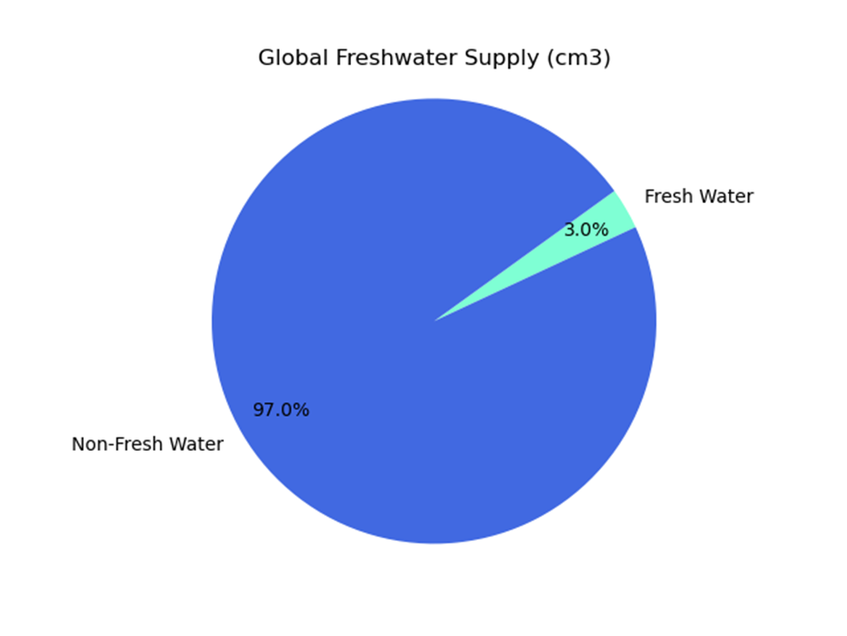
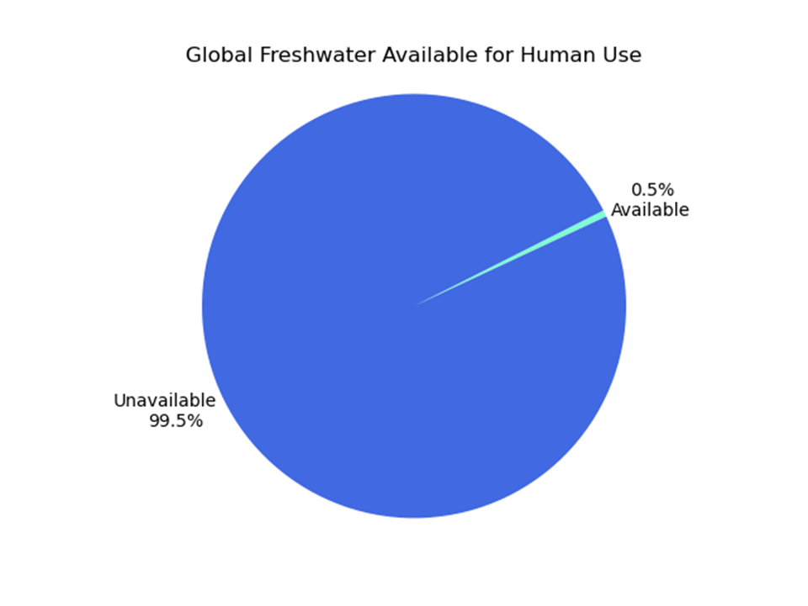
Why explore Water?
Water is critical to human survival.
Only 3% of the world's water is freshwater, and only 0.5% is available for human use.
Water is inherently scarce, which could increase conflict.

Slide 4
Project Summary
Task 1: Data Collection
Task 2: Data Cleanup
Task 3: Data Integration
Task 4: Analysis and Visualization
Topics
Does water scarcity correlate with frequency and intensity of armed conflicts?
What are the geographical patterns of conflict relative to water scarcity?
Are certain types of conflicts more likely to occur in water-scarce regions?
Are there other factors that affect the frequency of armed conflicts in water scarce areas?
Sociopolitical
Geographical

Slide 5
Task 1: Data Collection
Bureau of Reclamation: Global Water
Food and Agriculture Organization (FAO): Water Stress
University of Alabama: Militarized Events
Correlates of War (COW): Countries
GitHub: Regions & Sub-Regions
World Bank Group: Political Stability, Precipitation, Freshwater
International Monetary Fund: Surface Temperature
Our World In Data: Political Regime
Our World in Data: GDP Per Capita

Slide 6
Task 2: Data Cleanup
Militarized Events Data provided data for eventnum as a sequential battle in a greater war or conflict represented by micnum.
We compared the datasets and selected a date range where data was well represented: 1980 - 2014
We kept null values
Formatted Countries for merging csv files

Slide 7
Task 3: Data Integration
We individually integrated cleaned up csv files within our topic areas. This allowed us to select which datasets applied to our specific topic areas for analysis.
Geoapify API was used to access geographical data

Slide 8
Task 4: Analysis and Visualization
Does water scarcity correlate with frequency and intensity of armed conflicts?
What are the geographical patterns of conflict relative to water scarcity?
Can changes in water availability predict increases in conflict events?
Are there other factors that affect the frequency of armed conflicts in water scarce areas?
Sociopolitical
Geographical

Slide 9
1. How does water scarcity correlate with the frequency and intensity of armed conflicts?

Slide 10
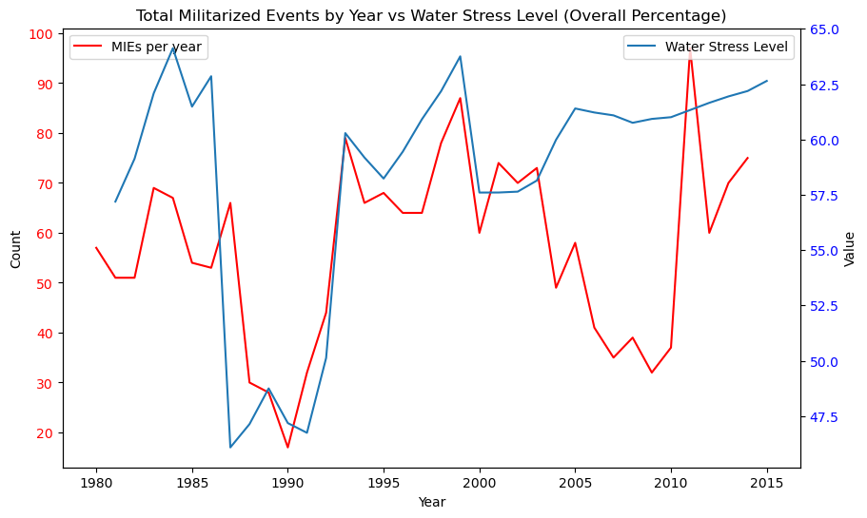
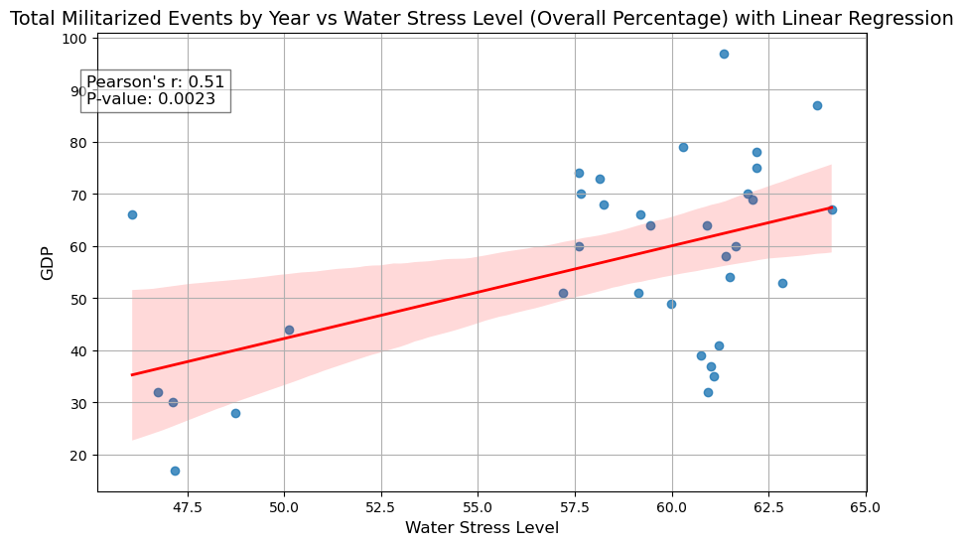
Global Conflicts and Water Stress
Moderate positive linear correlation (r = 0.51)
Strong evidence against the null hypothesis (p = 0.0023)

Slide 11
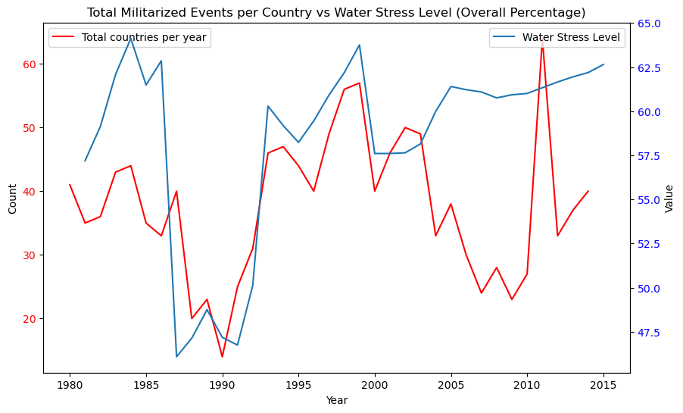
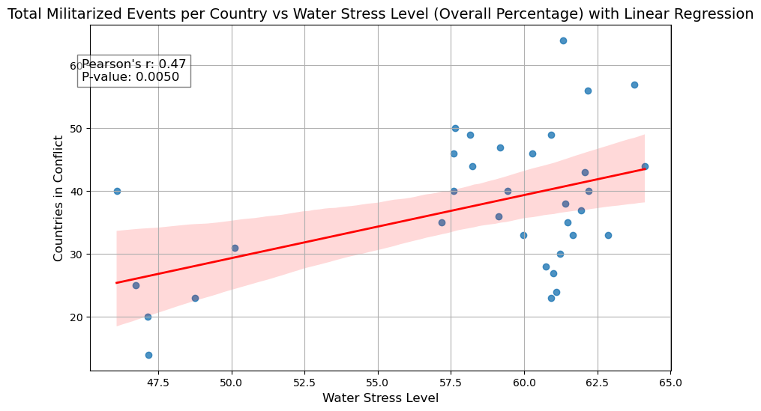
Conflicts by country vs. Water Stress
Moderate positive linear correlation (r = 0.47)
Strong evidence against the null hypothesis (p = 0.005)

Slide 12
2. What are the geographical patterns of conflict relative to water scarcity? 3. Can changes in water availability predict increases in conflict events?

Slide 13
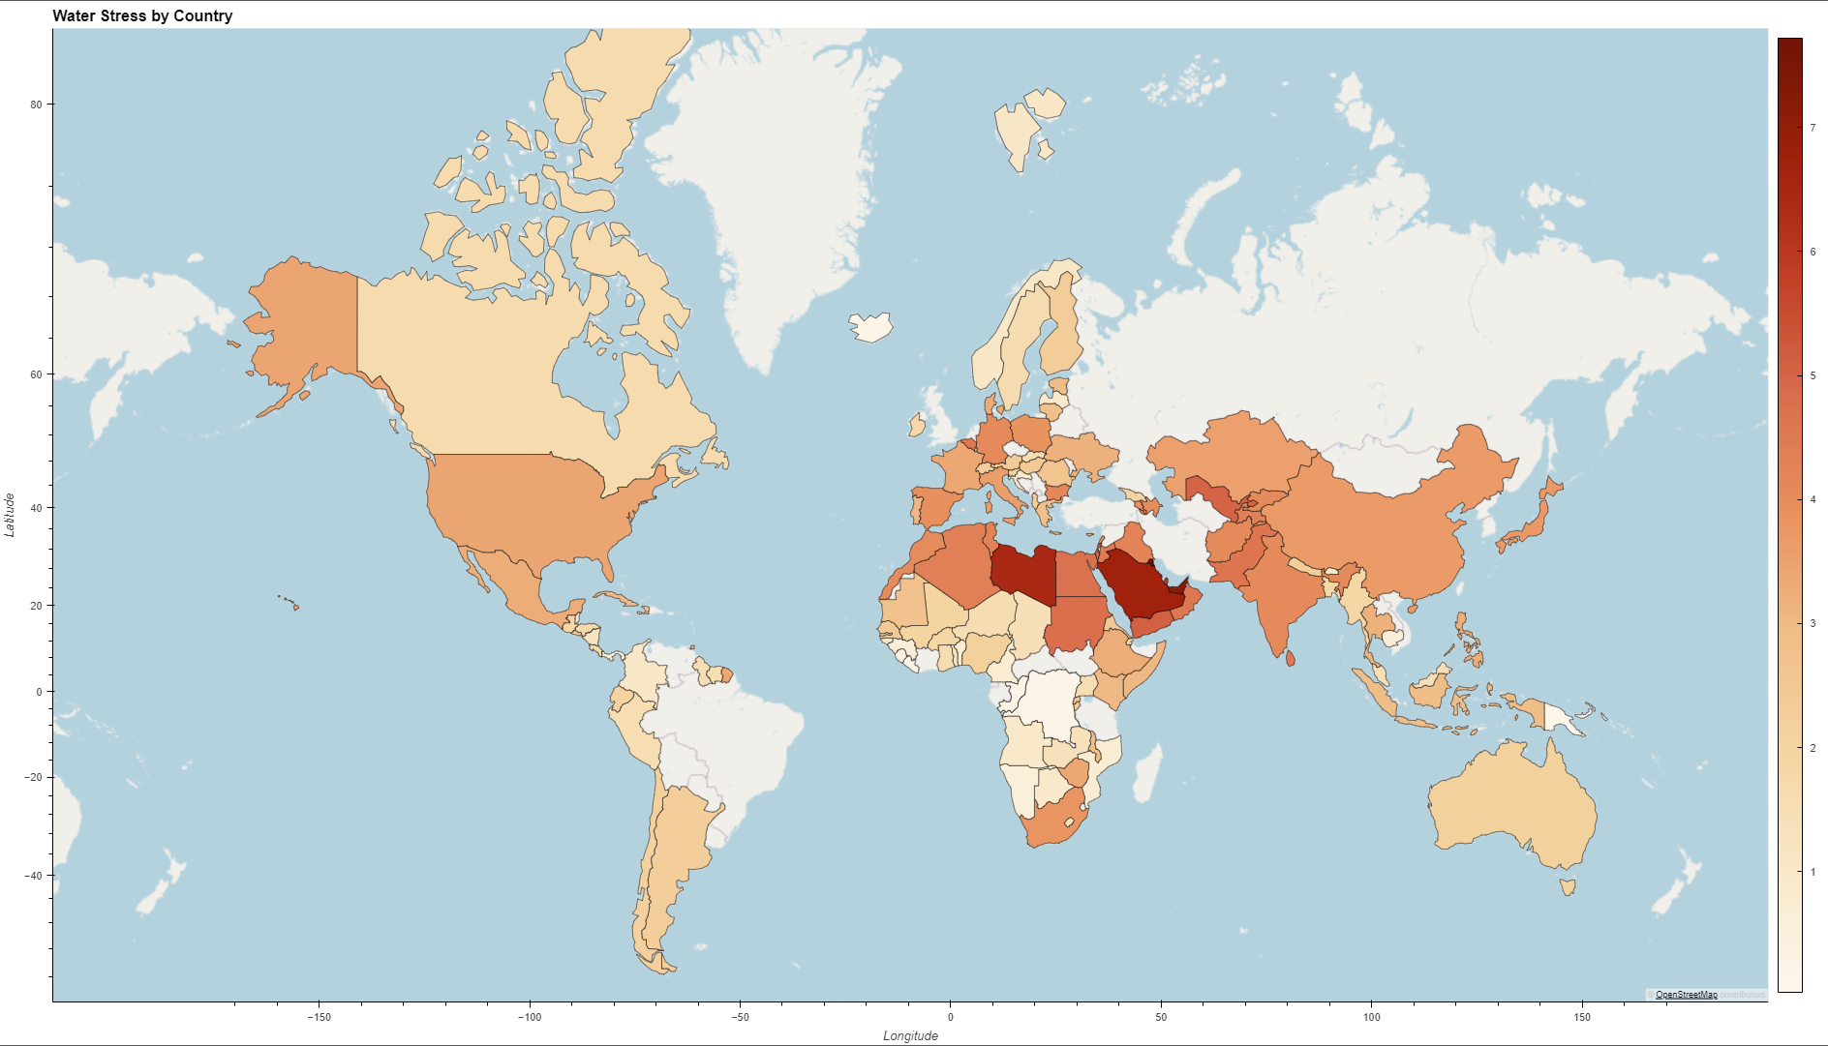

Slide 14
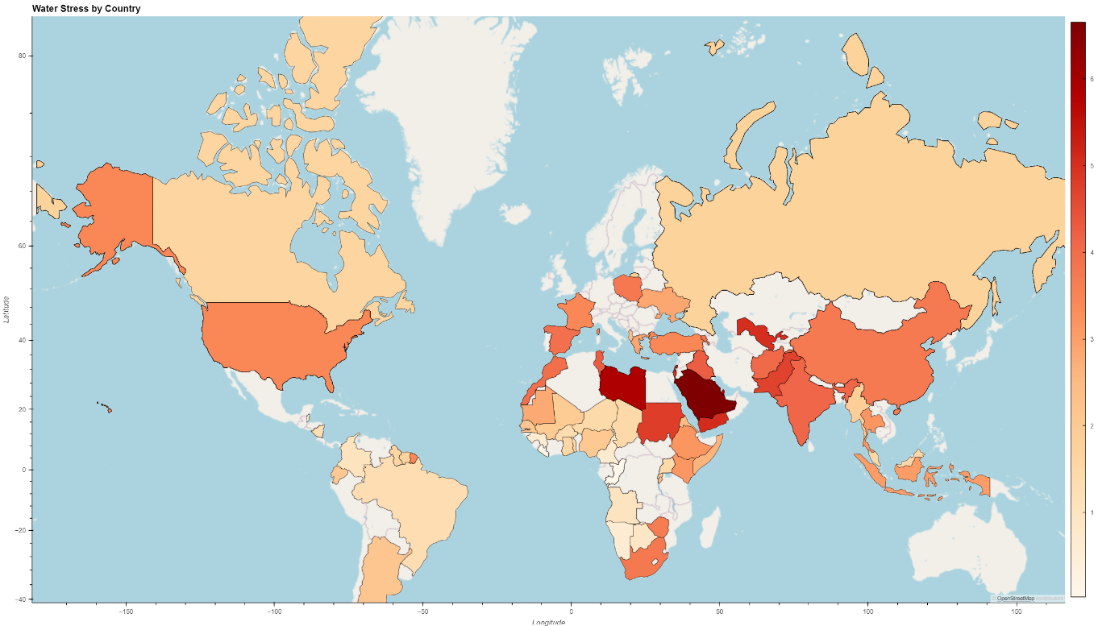

Slide 15
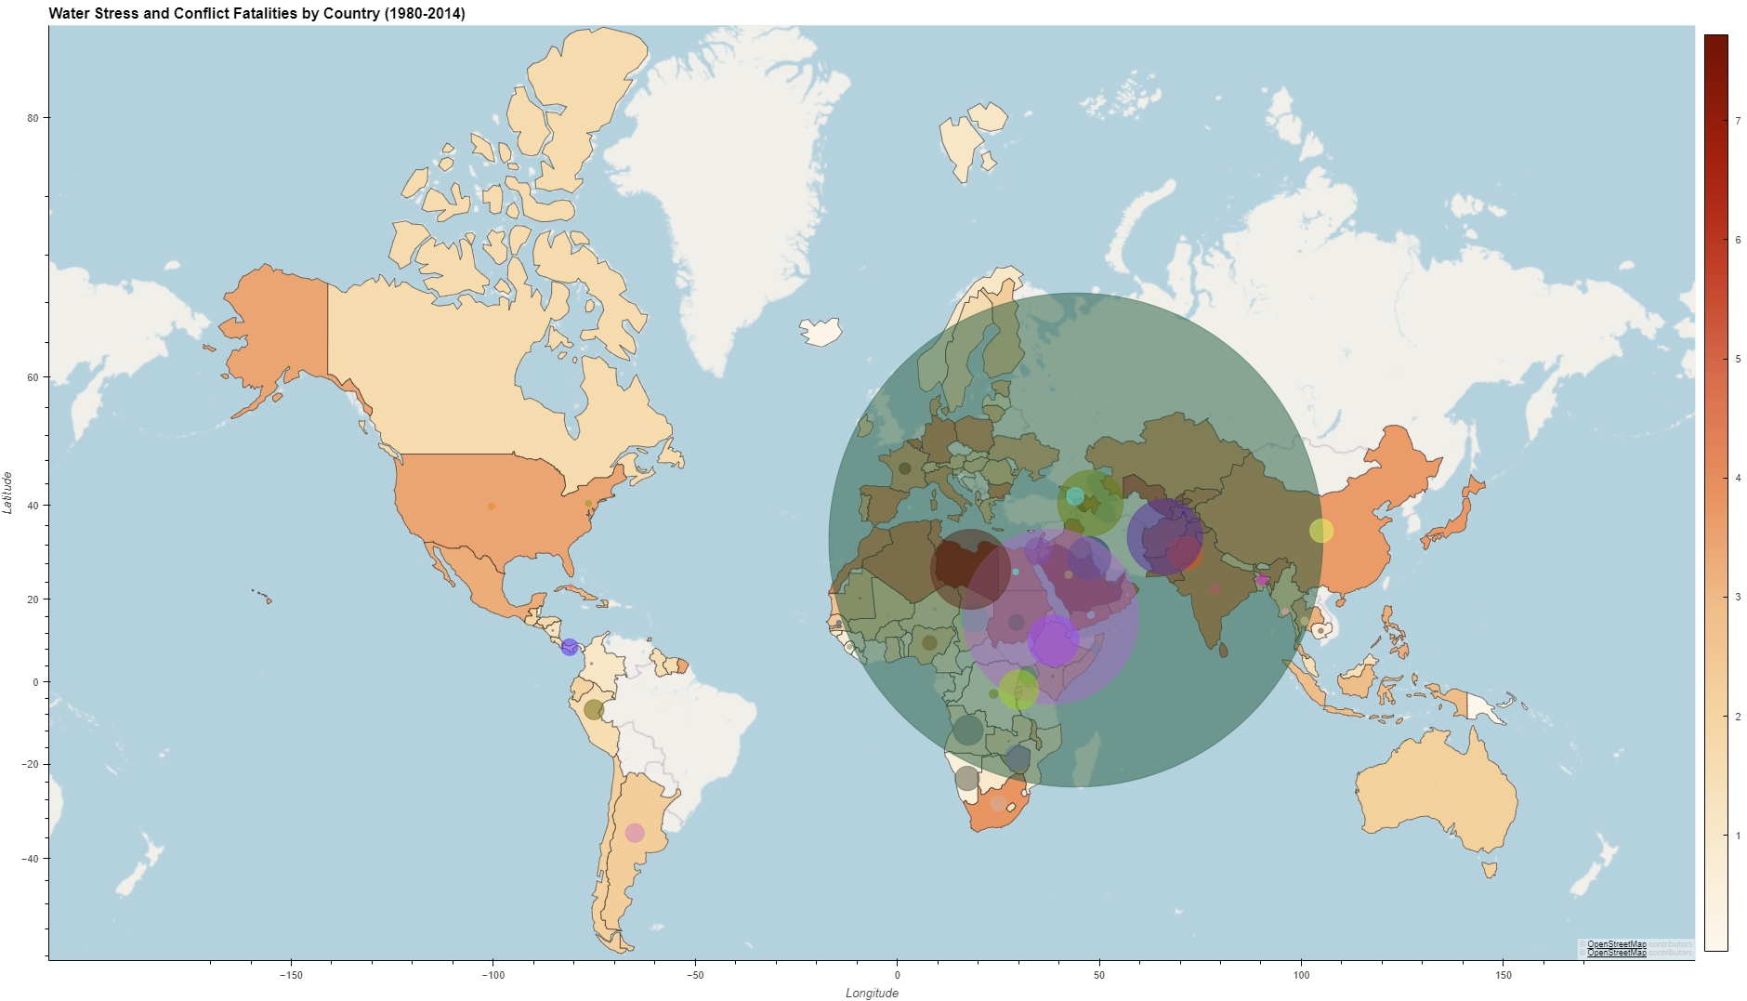

Slide 16
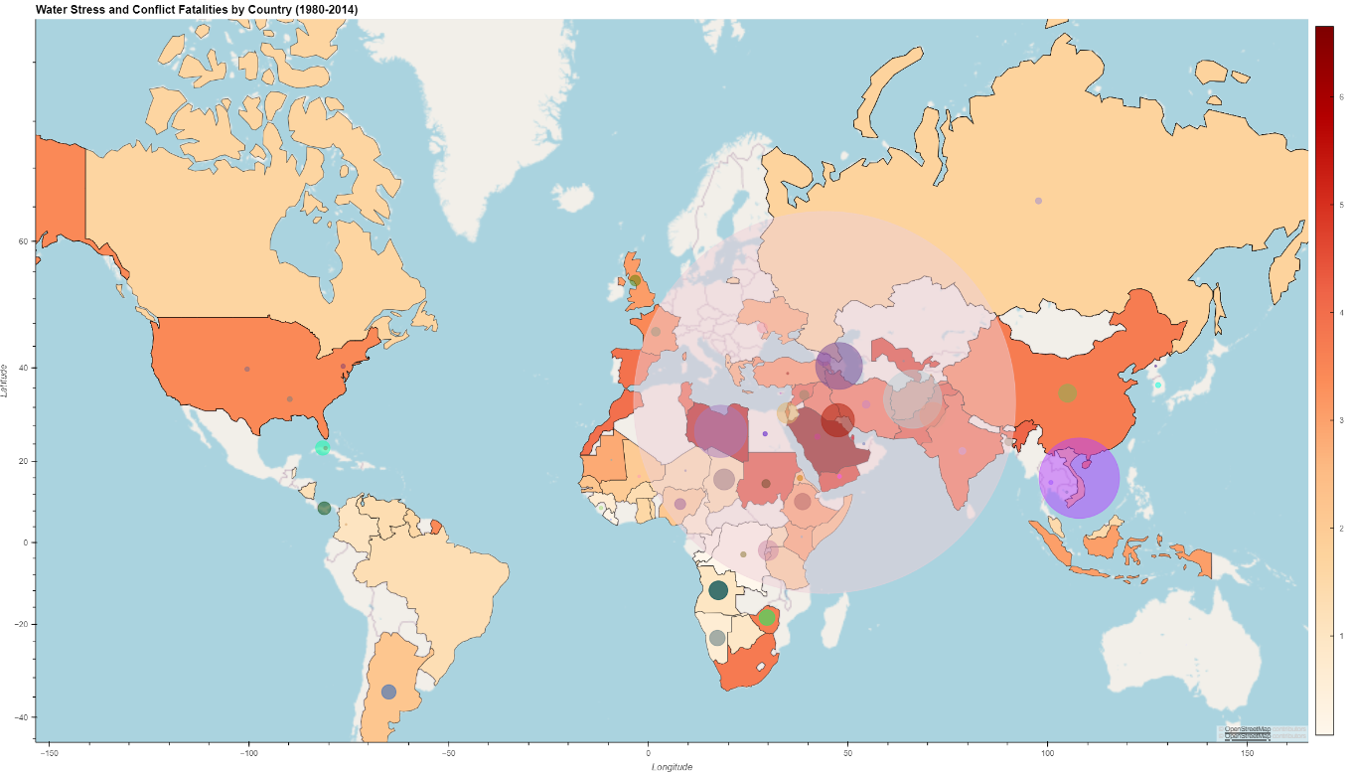

Slide 17
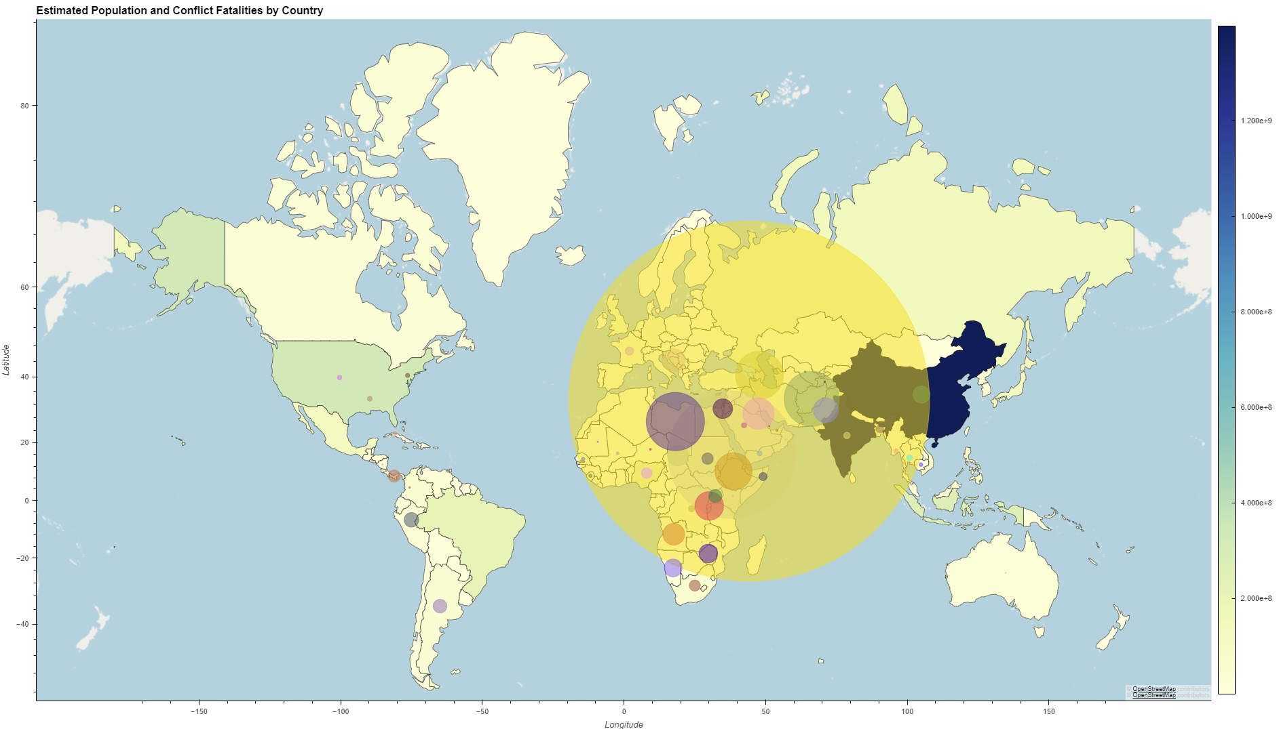

Slide 18
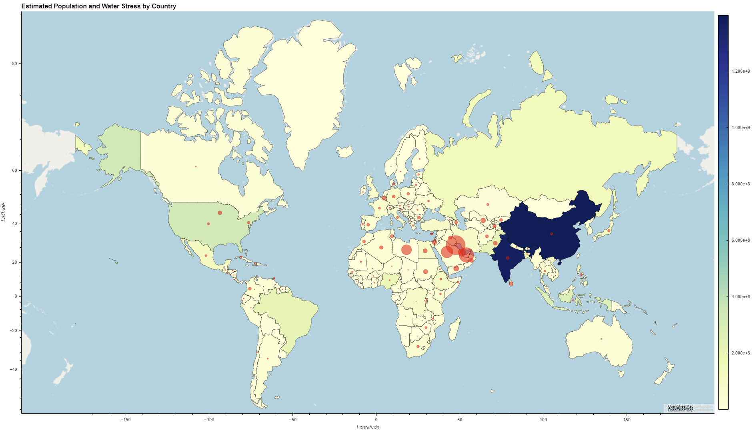

Slide 19
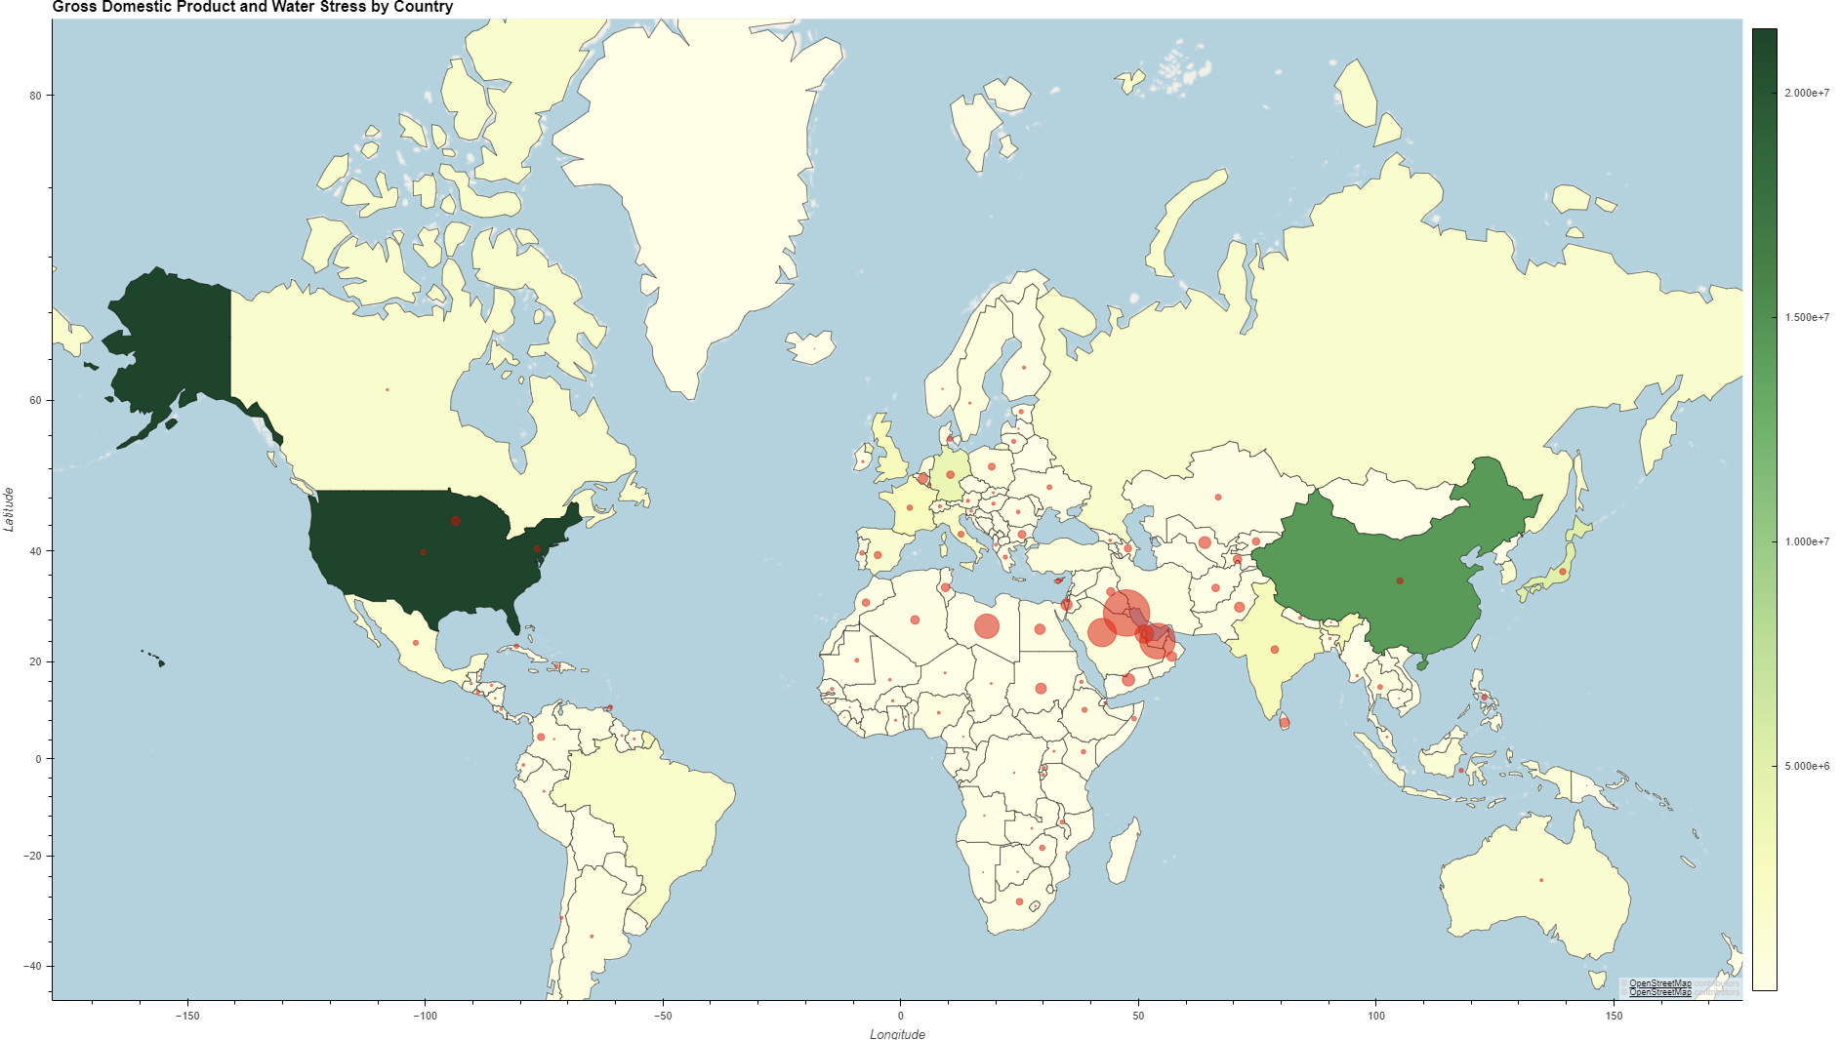

Slide 20
4. Are there other factors that affect the frequency of armed conflicts in water scarce areas?

Slide 21
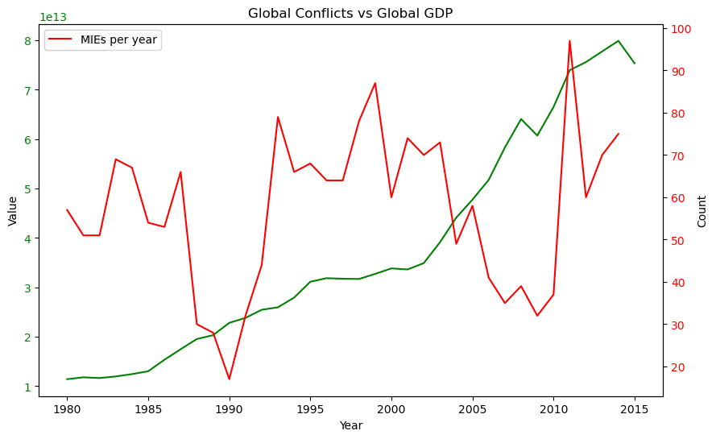
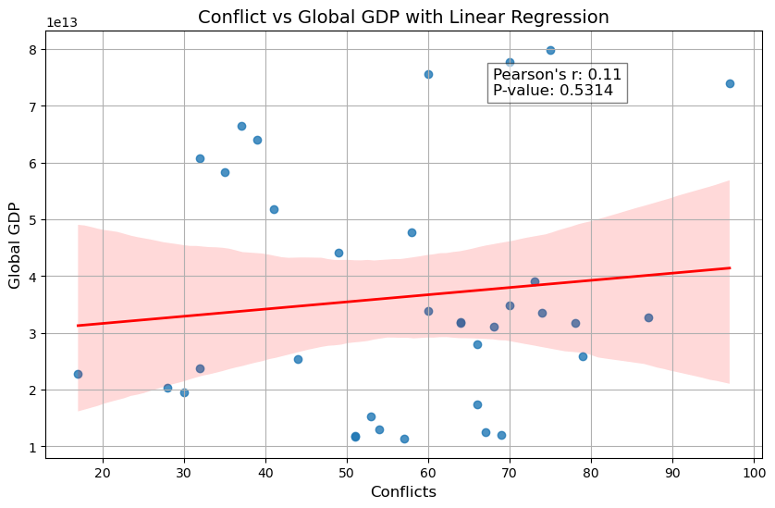
Global GDP
Weak positive linear correlation (r = 0.11)
Weak evidence against the null hypothesis (p = 0.5314)

Slide 22
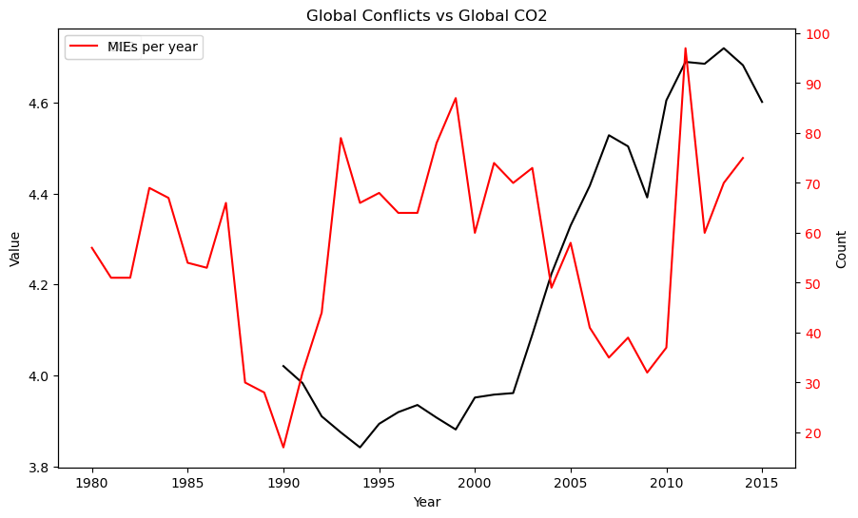
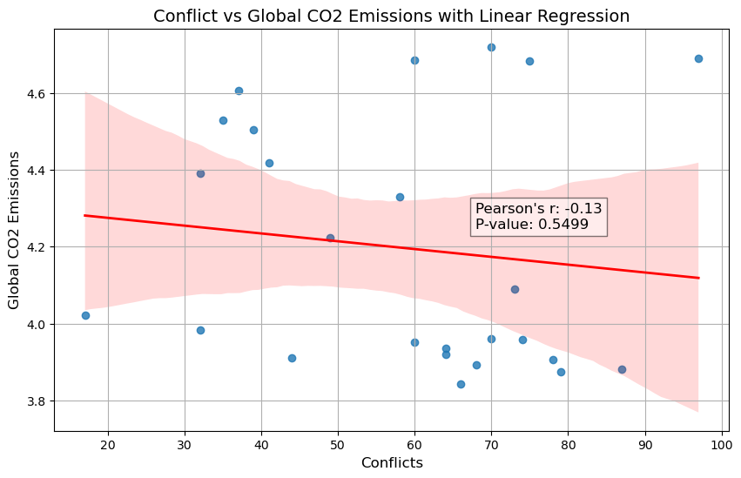
Global CO2 Emissions
Weak negative linear correlation (r = -0.13)
Weak evidence against the null hypothesis (p = 0.5499)

Slide 23
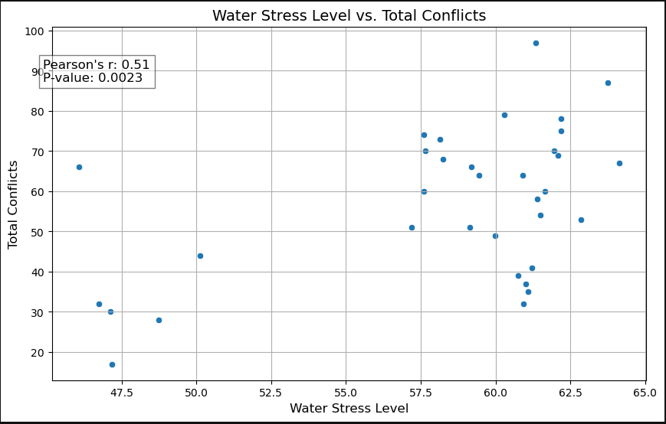

Slide 24
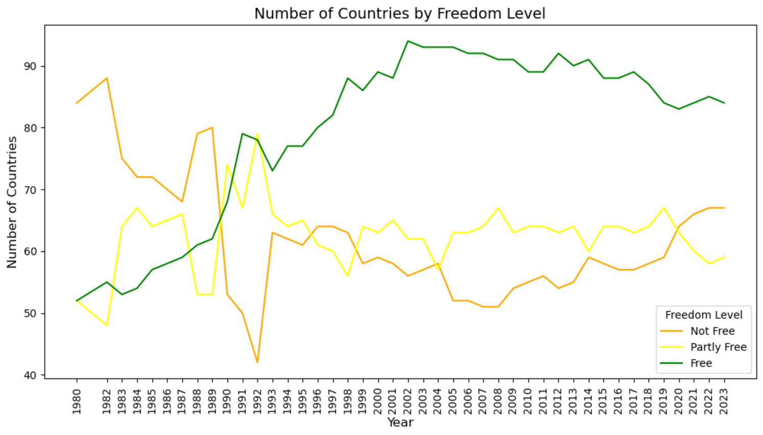
Degree of Political Freedom
Notes:
Since 1980, the number of countries that are considered "Free" by "Our World in Data" has drastically increased, where in 1980 there were over 80 "Not Free" countries and just over 50 "Free" countries, but now there are over 80 Free countries and less than 70 Not Free and Partly Free countries.
The levels are defined as follows:
-Free countries are understood as countries in which citizens have many political rights (free and fair elections, political pluralism and participation, functioning government) and civil liberties (freedoms of expression and association, rule of law, personal autonomy).
-Partly free country are countries in which citizens have some political rights and civil liberties.
-Not free country are countries in which citizens have few political rights and civil liberties.

Slide 25
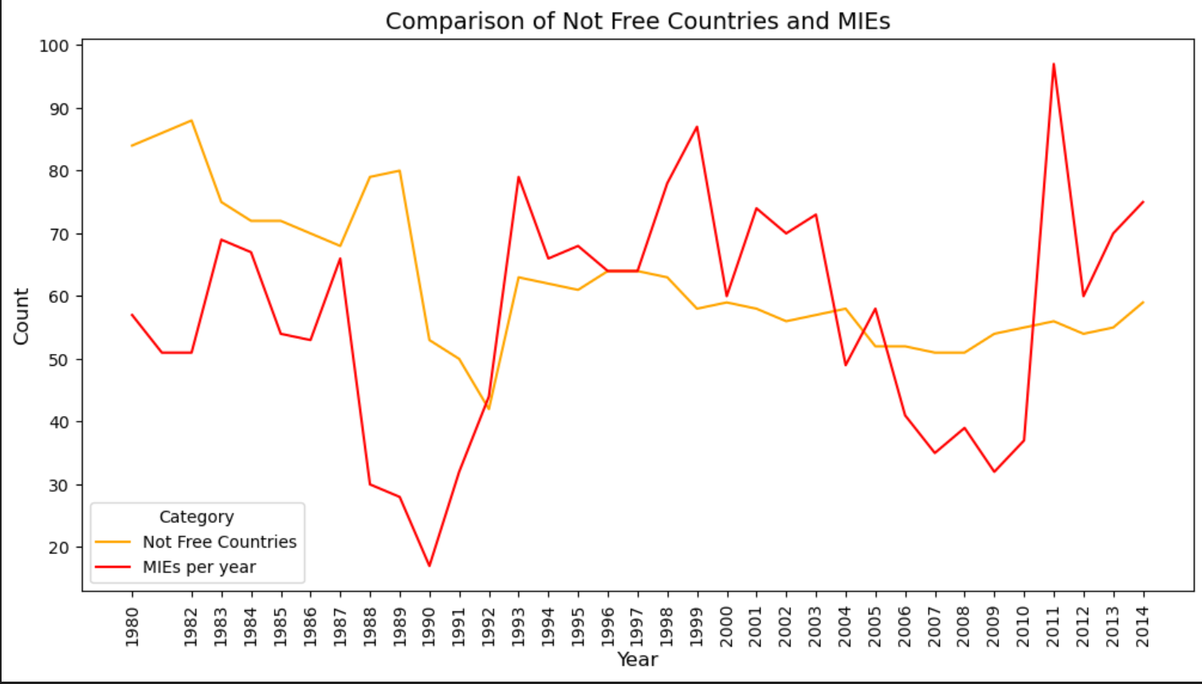
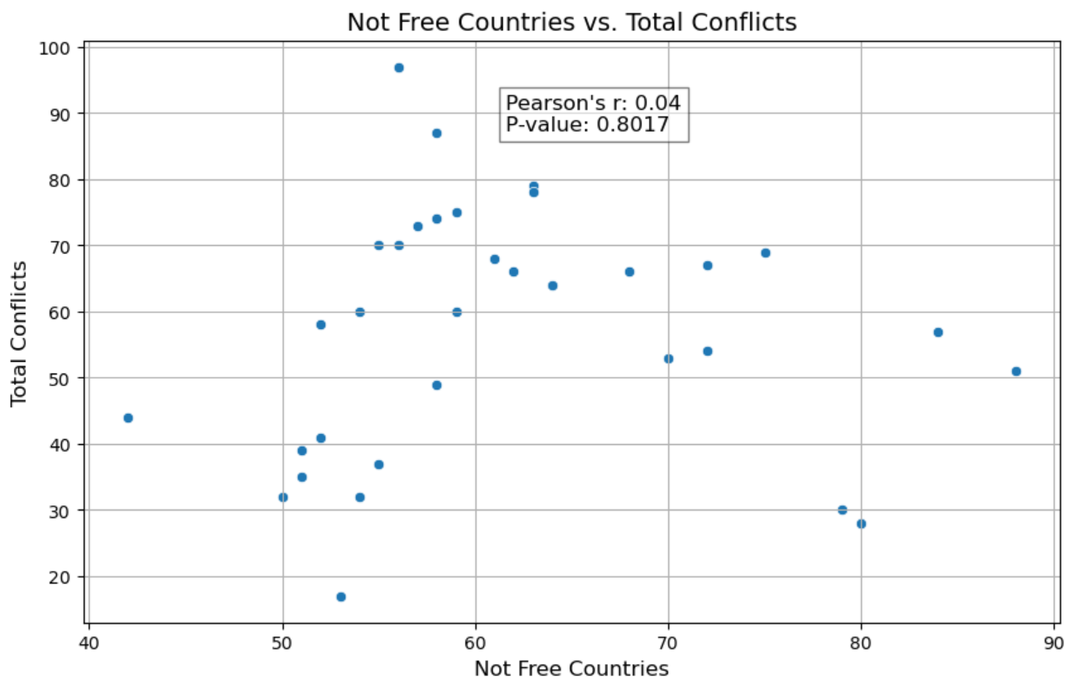
Degree of Political Freedom
Notes:
Is there a correlation between the number of Not Free countries and the number of conflicts, as well as the Water Stress Levels?
When the Not Free countries are compared to the number of Militarized Events per year, there seems to be some similarities. However, in the statistical analysis, Pearson's r for this correlation was 0.04, and the p-value was 0.8017, indicating that there is a weak positive correlation between the Not Free Country and Total Conflict variables, and any correlation that is present has a high probability of occurring by random chance.

Slide 26
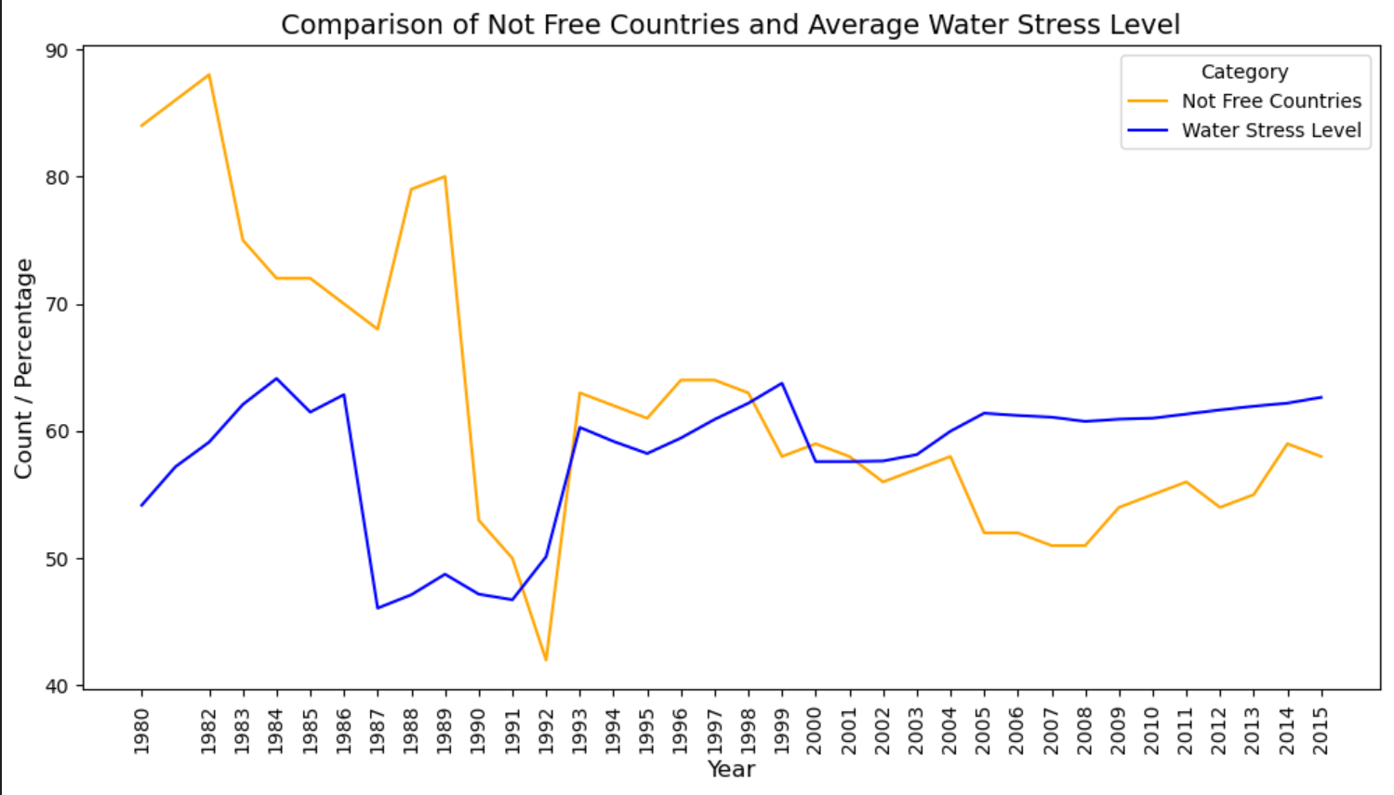
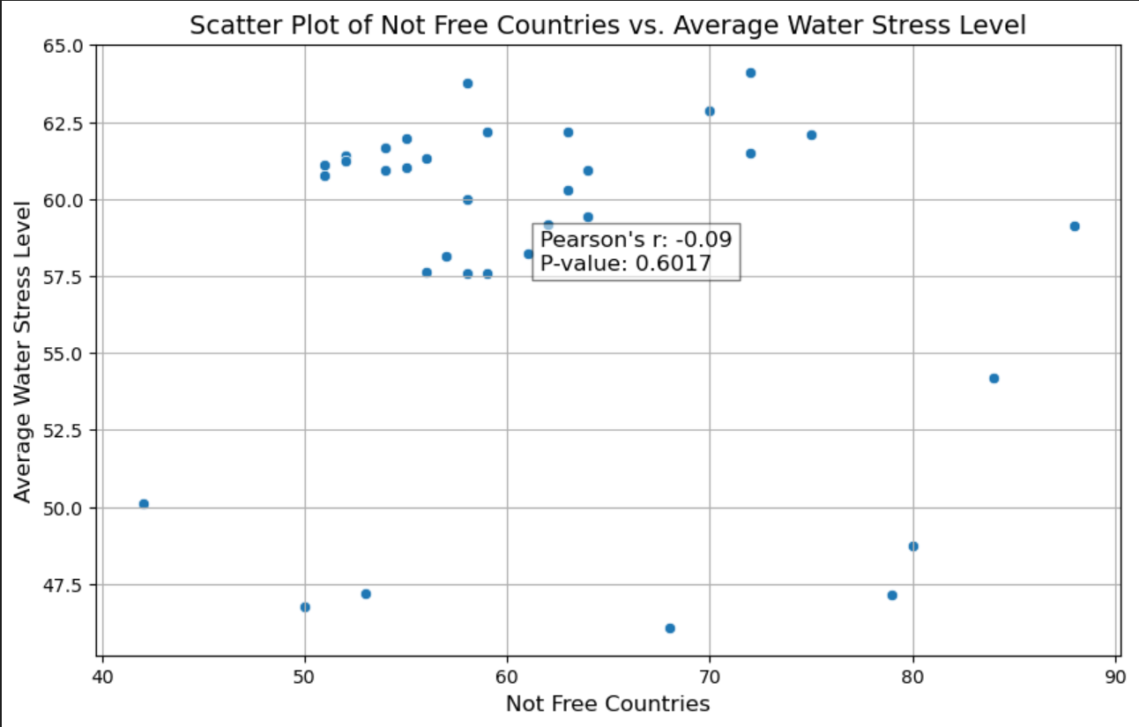
Degree of Political Freedom
Notes:
The comparison between Not Free Countries and Average Water Stress level also seems to have a correlation, however Pearson's r was -0.09, indicating even less correlation between the two, and a p-value of 0.6017 also indicates that the weak correlation probably occurred by random chance.

Slide 27
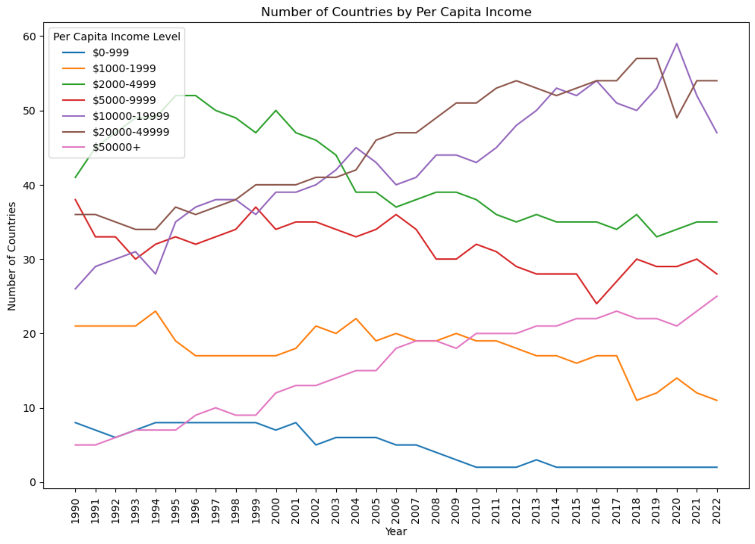
Per Capita Income
Notes:
"Our World in Data" split the countries of the world into 7 groups by Per Capita Income. Most countries in the world fall into the $2000-$49999 Per Capita Income range.
Countries in the $2000-$50000 Per Capita Income range experienced higher levels of conflict than the other income bins.

Slide 28
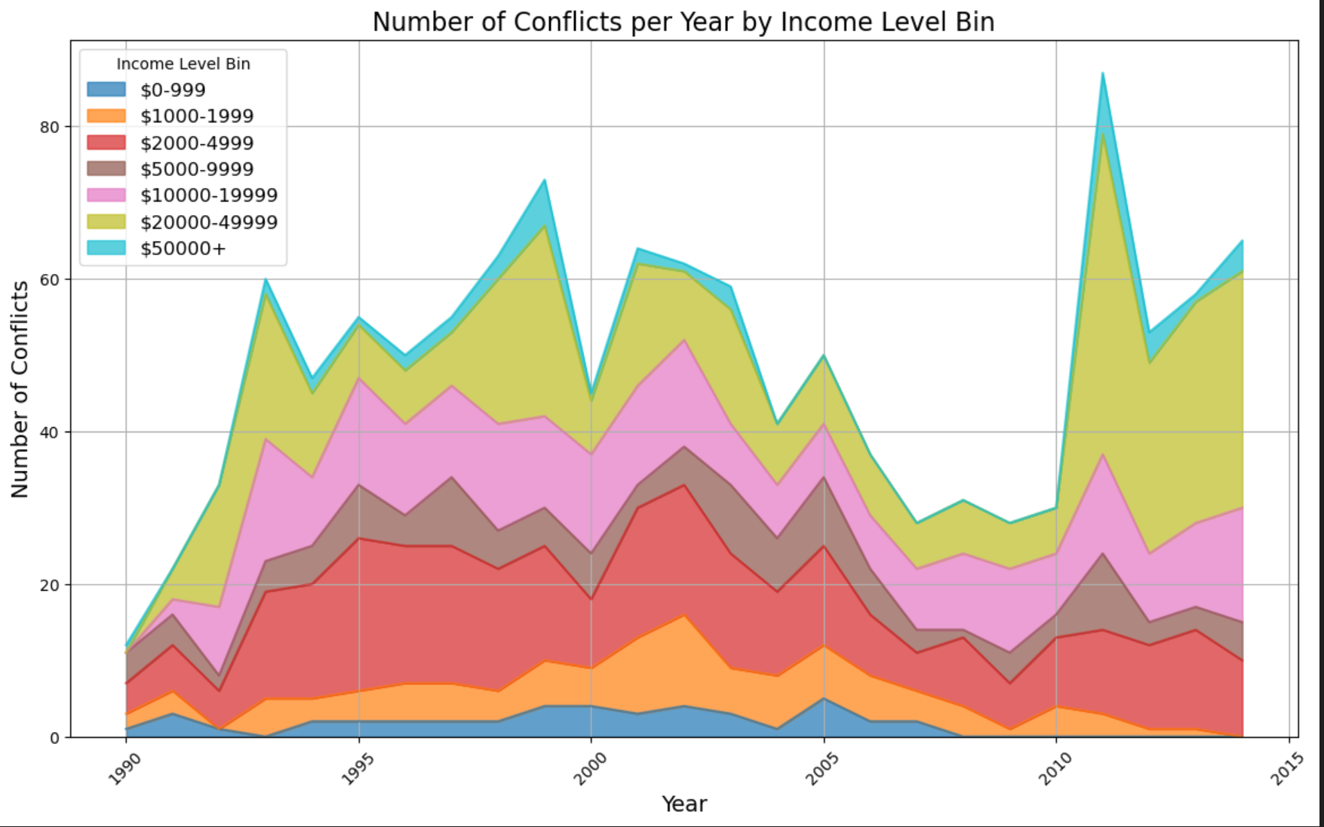
Per Capita Income
Notes:
"Our World in Data" split the countries of the world into 7 groups by Per Capita Income. Most countries in the world fall into the $2000-$49999 Per Capita Income range.
Countries in the $2000-$50000 Per Capita Income range experienced higher levels of conflict than the other income bins.

Slide 29
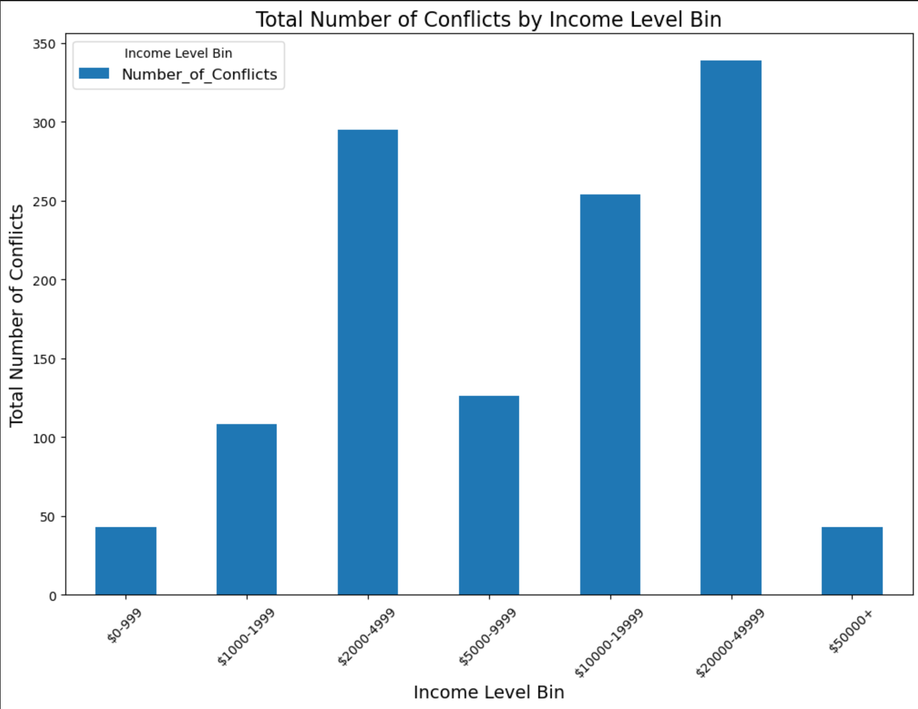
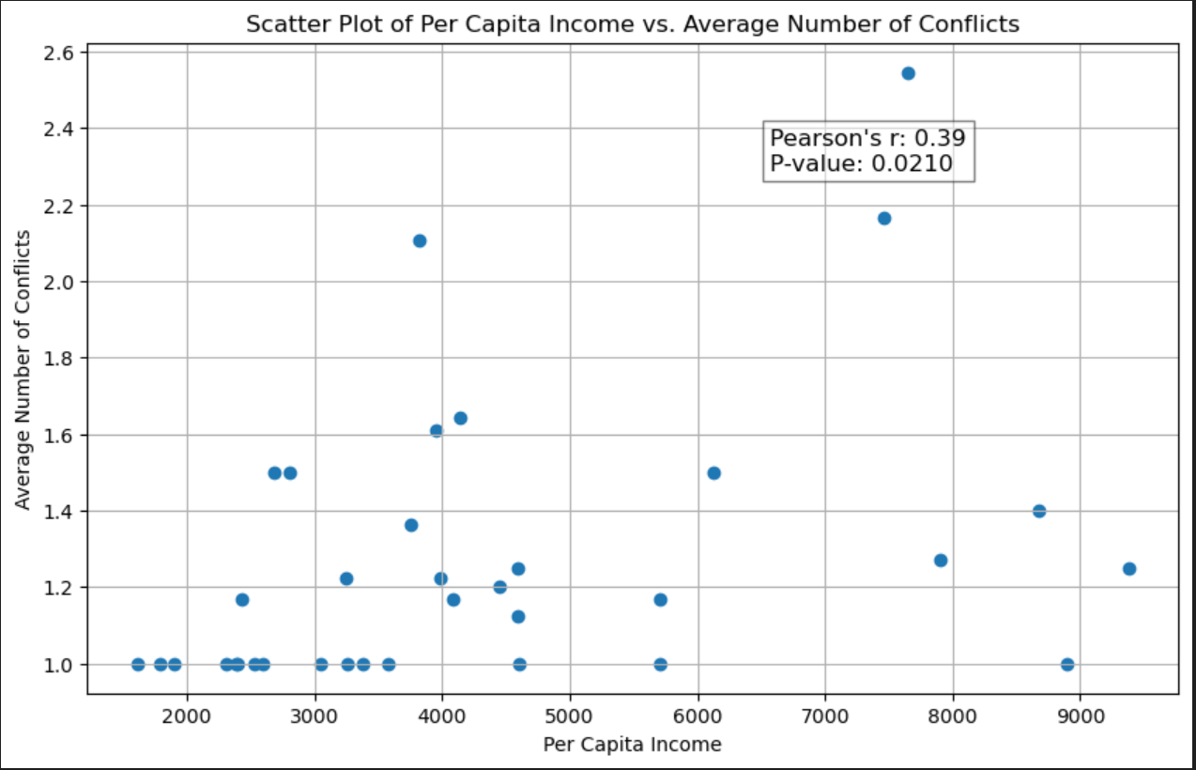
Per Capita Income
Notes:
We wanted to see if there was any correlation between being in a specific income level and experiencing higher levels of conflicts.
The statistical analysis showed with a Pearson's r of 0.39 that the correlation between these two variables is moderate to strong, meaning countries in the $2000-4999 bin are more likely to experience conflict. The p-value of 0.0210 shows that the observed correlation is statistically significant.

Slide 30
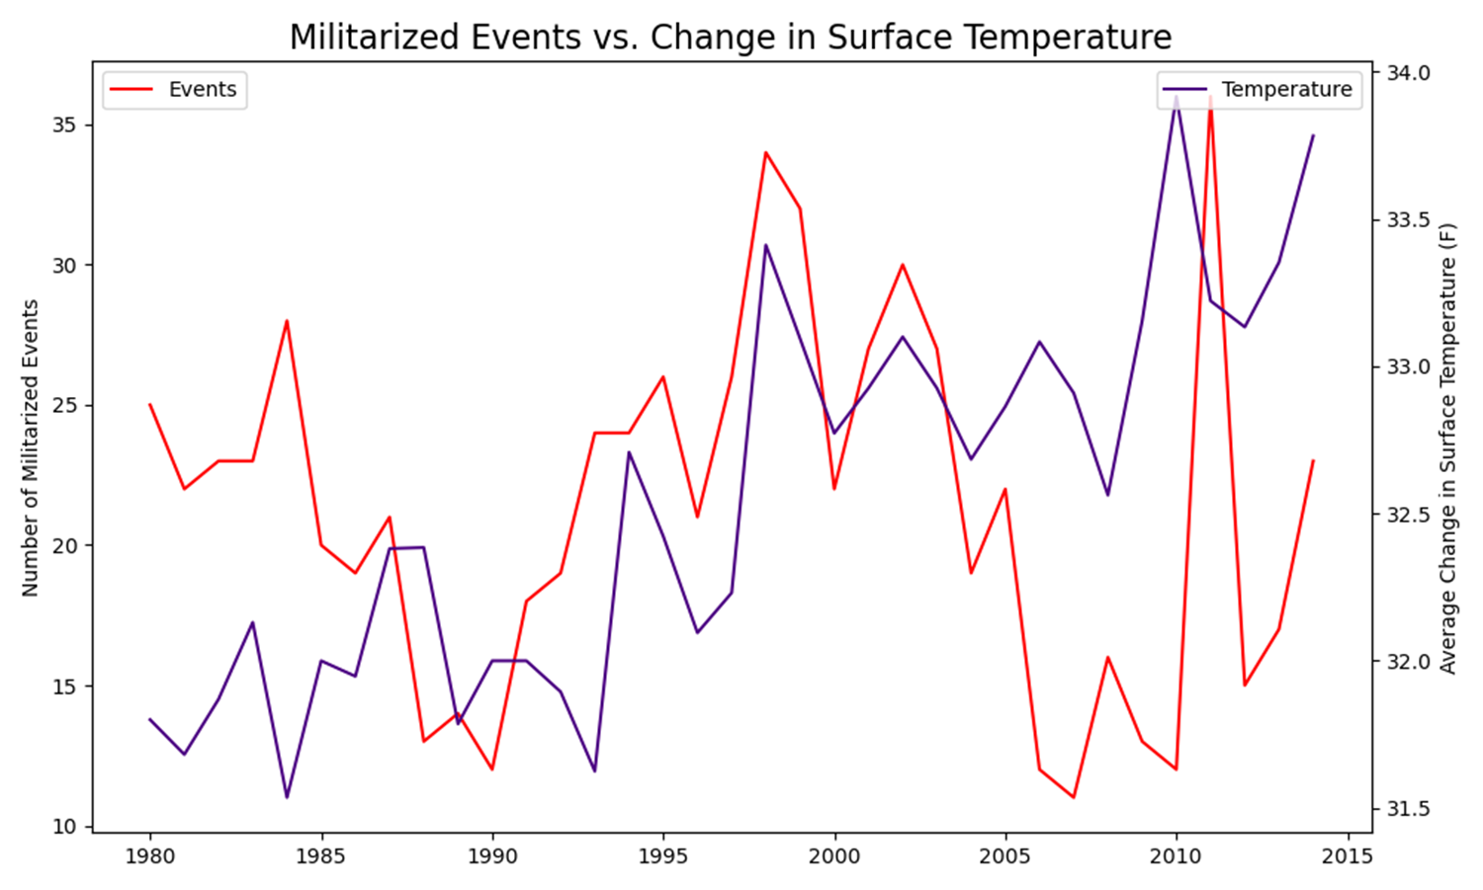
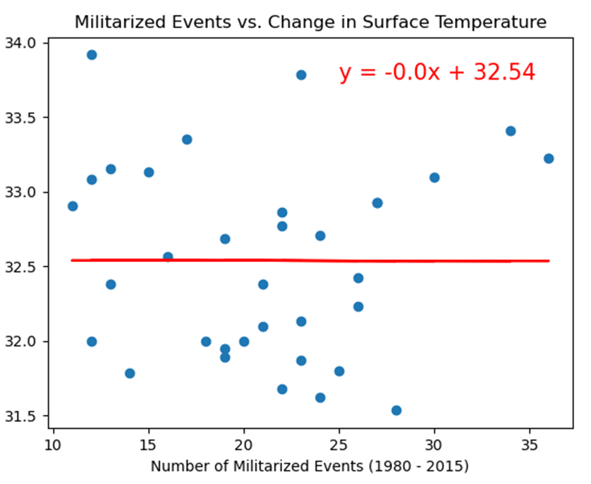
Average Surface Temperature
The calculated r-value is 0.00, indicating no linear correlation.
This is not a good measure of predictability for militarized events.

Slide 31
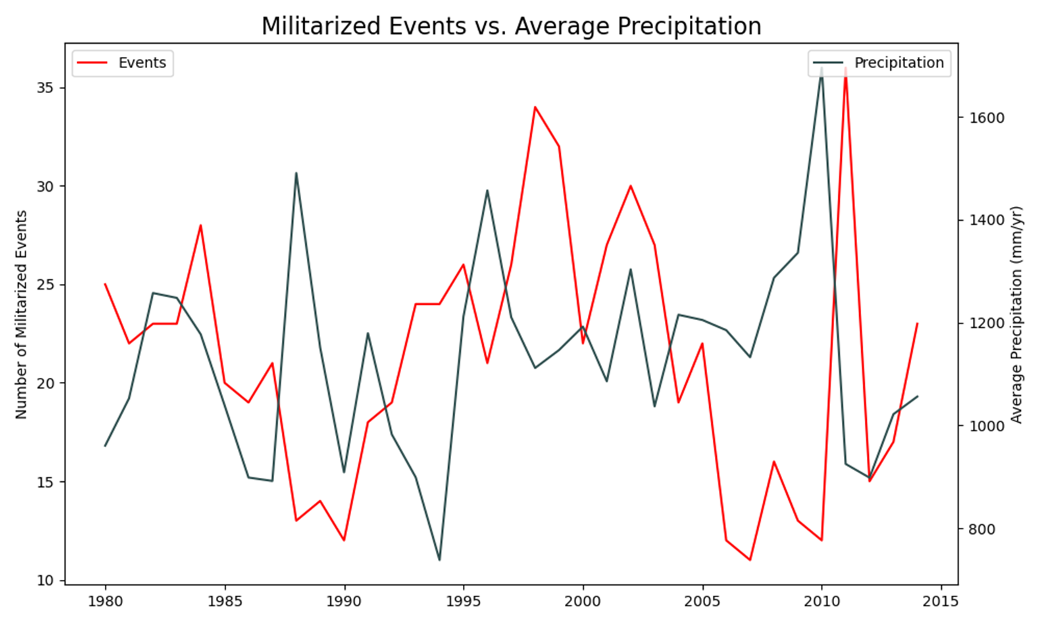
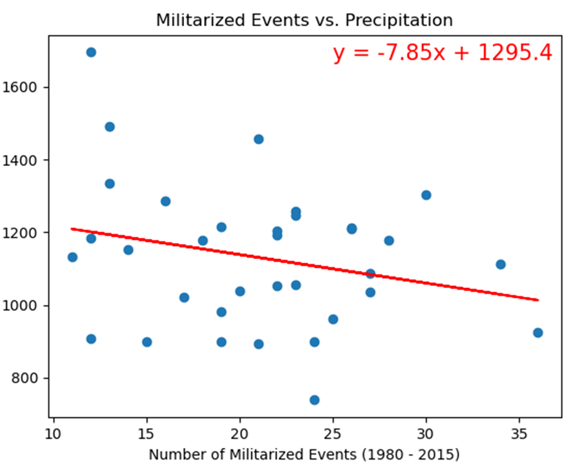
Average Precipitation
The calculated r-value is 0.06 with a negative slope, indicating a very weak negative linear correlation.
This is not a good measure of predictability for militarized events.

Slide 32
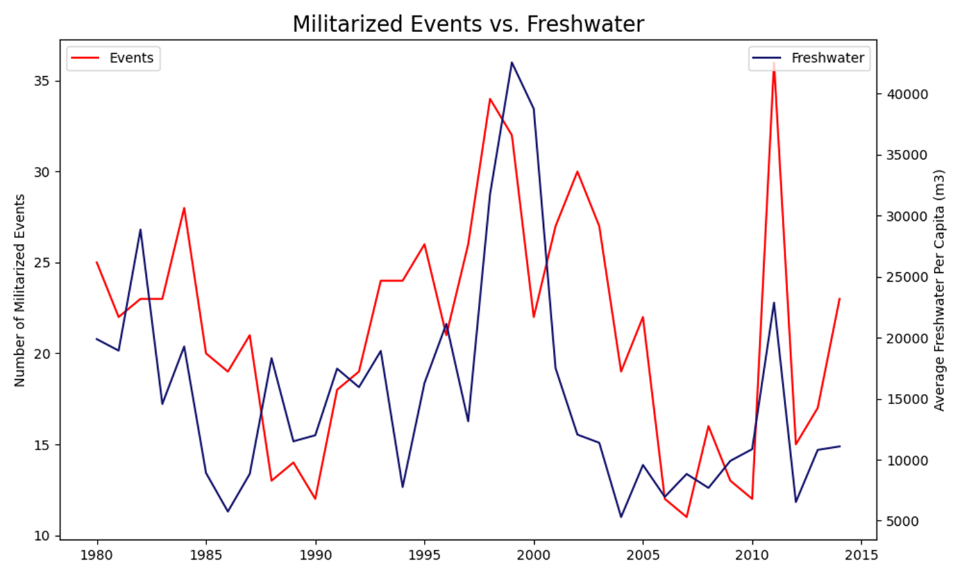
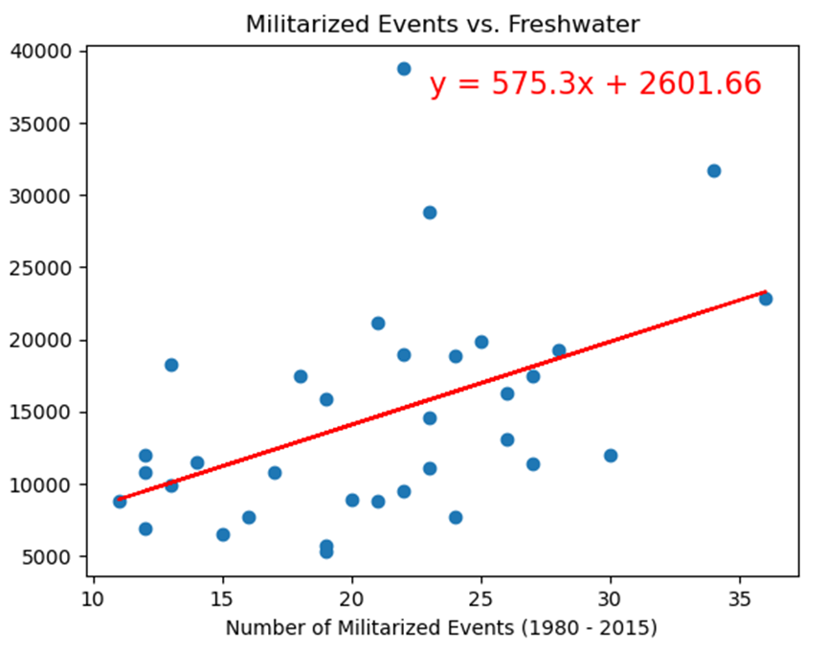
Average Freshwater Per Capita
The calculated r-value is 0.22 with a positive slope, indicating a weak positive linear correlation.
This alone is not a good measure of predictability for militarized events.

Slide 33
Summary
Analysis suggests there is a moderate positive correlation between conflict and water stress.
Although other variables also showed a positive correlation to conflict, water stress was by far the strongest
Analysis did not provide information on causation (increased water stress causes increased conflict or increased conflict causes more water stress), but results suggests there is an opportunity for further study to explore this correlation.

